Slide 1
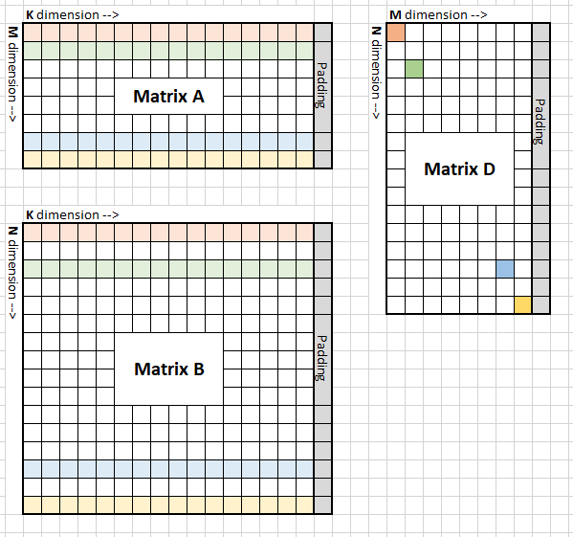
Auto generator
Example :
Data type: bf16
Gemm format: column major
Gemm size: M = 960, N = 1024, K = 1024
Padding: 32DWORD
Mfma per wave: 1 * 2
Wave per group: 2 * 2
MT size: 64 * 128

Slide 2
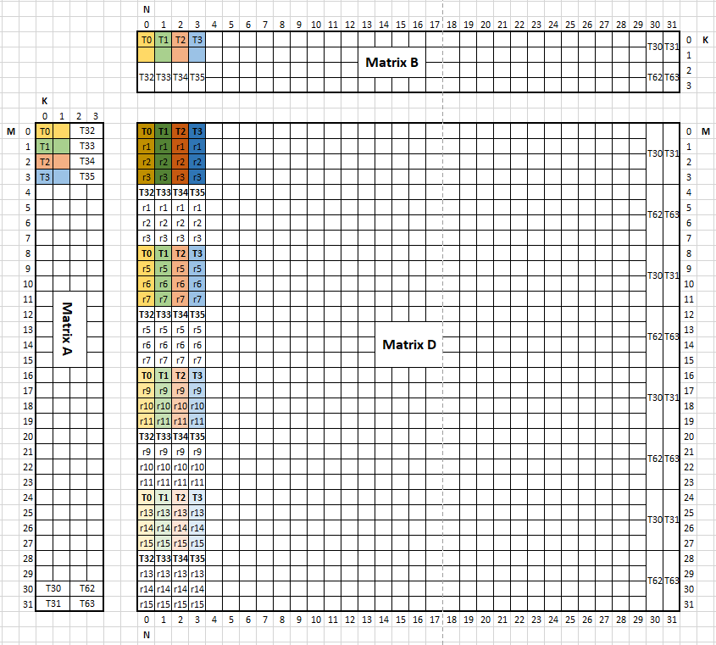
Auto generator
mfma:
Matrix A
M * K = 31 * 4
Every thread hold 2 elements in K dim
Matrix B
N * K = 31 * 4
Every thread hold 2 elements in Kdim
Matrix D
M * N = 31 * 31
Every thread hold 4 lane in M dim
Every lane has 4 elements in M dim
One lane of store
One tile for store

Slide 3
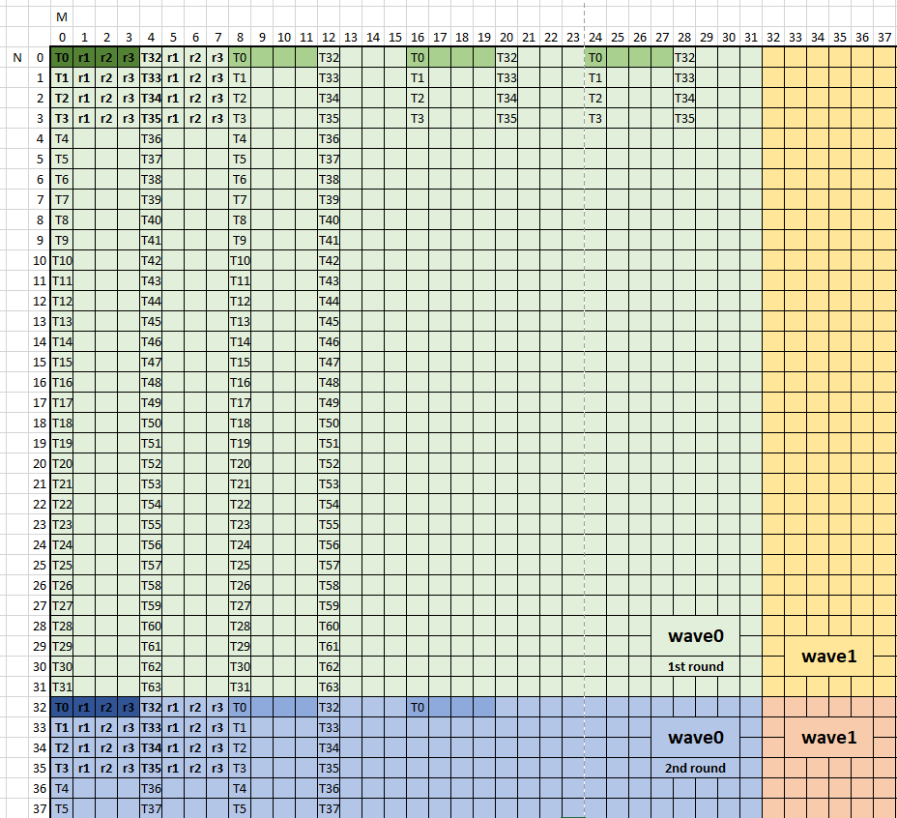
Auto generator
Global store work load:
store instruction width:
1DWORD = 2 element
store amount:
mfma_tile * mfma_tile * round
= 4 * 4 * 2 = 32 elements / thread
Store round:
mfma per wave = 2 round
One tile for store
One lane of store

